Slide 1

GROCO
Sunny Kumar
&
Ankita
Guided by:
Ms. S.M Ashif
DISCOVER . LEARN . EMPOWER

Slide 2
Introduction
An online shopping portal can be accessed from any place wherever internet penetration is available.
The portal of online shopping can be accessed anywhere and anytime.
Desktop based Application is a project which aims in developing a computer based Desktop application to make Video Calling.
Online shopping is accessible to the customer for 24 hours and 365 days in a year.
Other buying decision factor is price which can be compared across several other online shopping websites.

Slide 3
Used Technology
The Complete project is made using HTML, CSS, JS.
HTML – It is used to design web pages using a markup language. HTML is the combination of Hypertext and Markup language. Hypertext defines the link between the web pages.
CSS – CSS is used to define styles for your web pages, including the design, layout and variations in display for different devices and screen sizes. .
JS – JavaScript is a lightweight, cross-platform, and interpreted compiled programming language which is also known as the scripting language for webpages. It is well-known for the development of web pages, many non-browser environments also use it.
The IDE which is used for the project is VS Code.

Slide 4
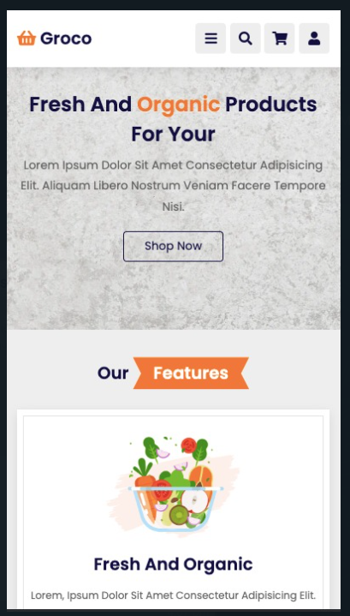
Need of the project
An online website or an app will be the face of your grocery business. Make sure the website or mobile application development is in the right hands, such as an experienced web design/app development company.
The success of your online grocery store depends heavily on a proper delivery management system that ensures seamless operation. This is arguably the most critical step in your journey to start your own online grocery store. In India, most consumers expect same-day delivery, especially when it comes to grocery items. Even a slight delay in this is heavily frowned upon. Taking in orders and not delivering them on time will cause irreparable harm to your grocery store. So it’s best to employ proper DMS to avoid such pitfalls.

Slide 5

Objective
The objective of this project are,
Disruptions in how consumers shop and buy food are a constant in today’s fast changing markets, and as online and mobile technologies have improved, the failed attempts to launch online grocery in the late 1990's appear to be a distant memory.
Death might not be imminent, but digital changes are certainly disrupting the way consumers shop and eat. We’ve found that early adopters in online grocery tend to be those shoppers more willing to let go of traditional notions of how to obtain food, just as these consumers are letting go of traditional notions of how to eat, when to eat and what to eat

Slide 6
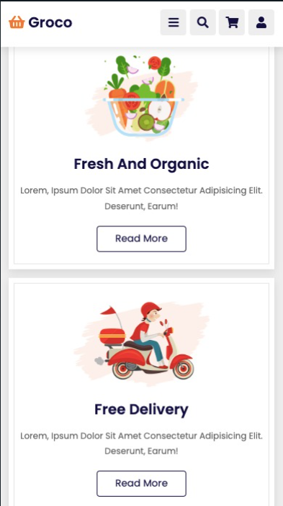
Working of the System
1. Firstly you have to open the desktop video calling application .
( You can download exe file from GitHub
https://github.com/sunnygit05/groco.git)

Slide 7
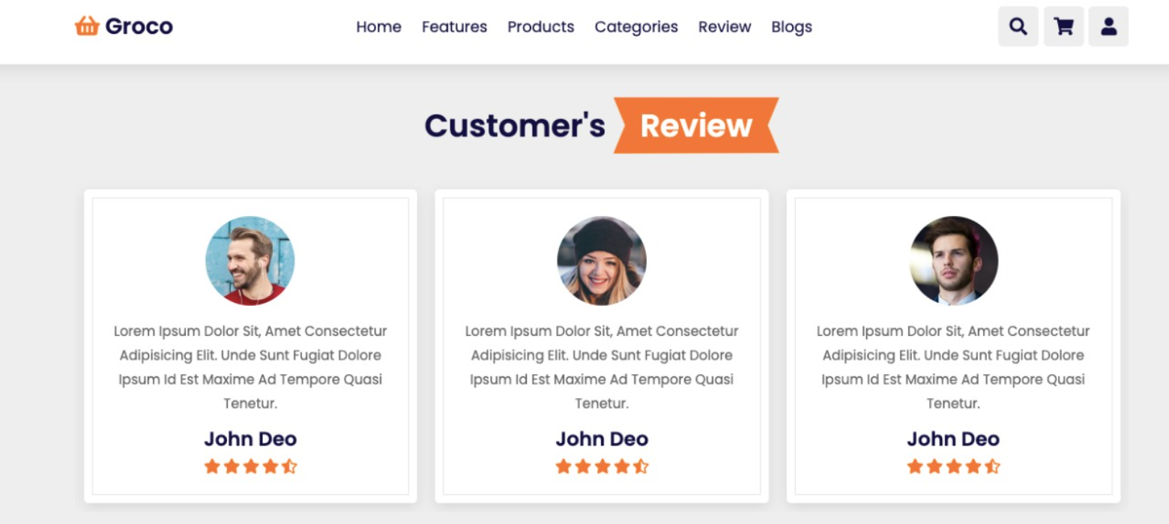
Working of the System

Slide 8
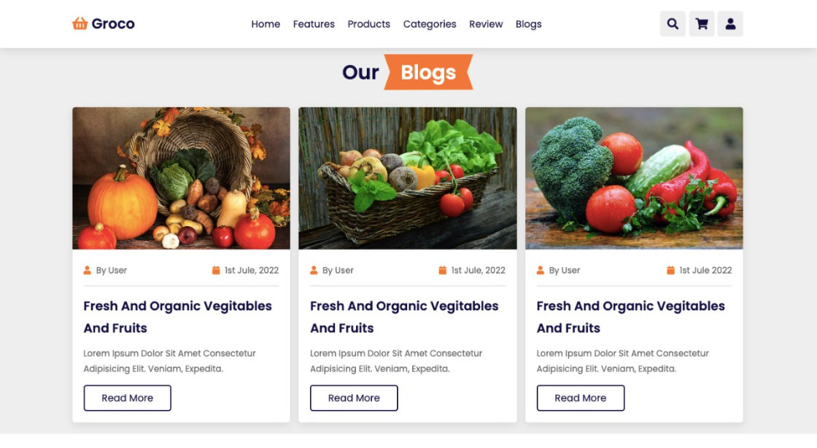
Working of the System

Slide 9
Future Scope
The internet, its popularity, and technological developments are a good mixture for any business. It is an undeniable fact regarding the future of online grocery delivery. It has not been a very long time since the food industry has turned to the internet way of doing things.
The demand for online grocery shopping is on the boom. 2022 seems to be a much-need fortunate turn for anyone who is either a part of this business or planning to begin with an online delivery store.
But before discussing the prospects, let’s throw light on some grocery delivery data through this blog.

Slide 10

THANK YOU

